Slide 1
Call1800.org using http://templatecycle.com/demo/bootclassified-v1.4/dist/index.html

Slide 2
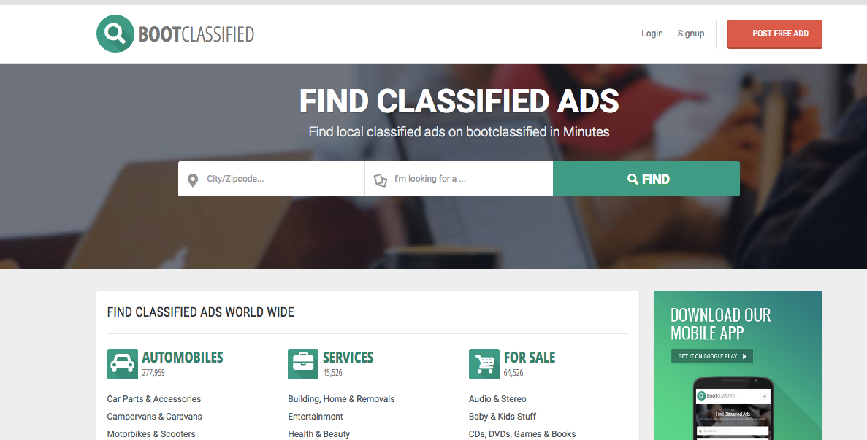
Overall layout keeps the same

Slide 3

Search Bar
Make this one Bar. They can enter business name or 1800 number
Thee should be two button: Call Now, Fine.
If they enter 1800 number, then the Call Now button is enable.
If they enter some text than the Find butotn will appear

Slide 4
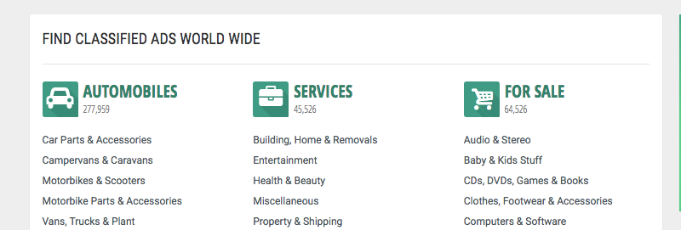
Classified
Change title to “FIND TOLL FREE NUMBERS IN US”
We keep the classifief as is.

Slide 5
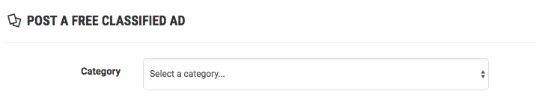
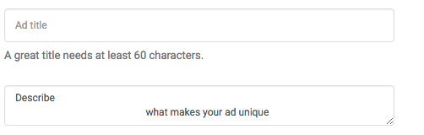


In the Post Now Page
POST A TOLL FREE NUMBER
Company Name
Company Description
Website
Toll Free Number

Slide 6

Login and Singup
Keep the same. Somone must be login before they can post.
If they are logged in already, they can Post.
If not, then they will be as to register or login first before they can post.

Slide 7
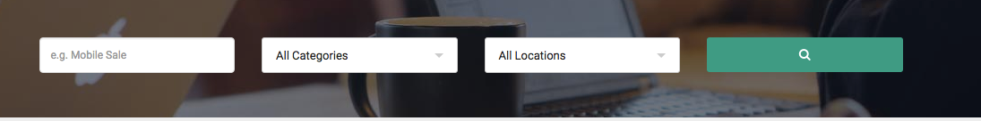
Search Listing
They can sepecify:
First box – Company Name
Second box – Category selectino
Third box – Toll Free Number

Slide 8
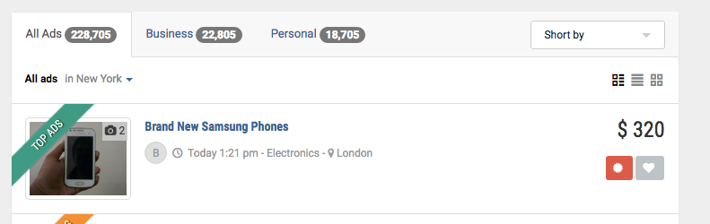
Search Result
Remove these 3 tags
Remove Image
ABC Mobile
1-800-xxx-xxxx
http://www.xxx.com
ABC Mobile is XXXXXX

Slide 9
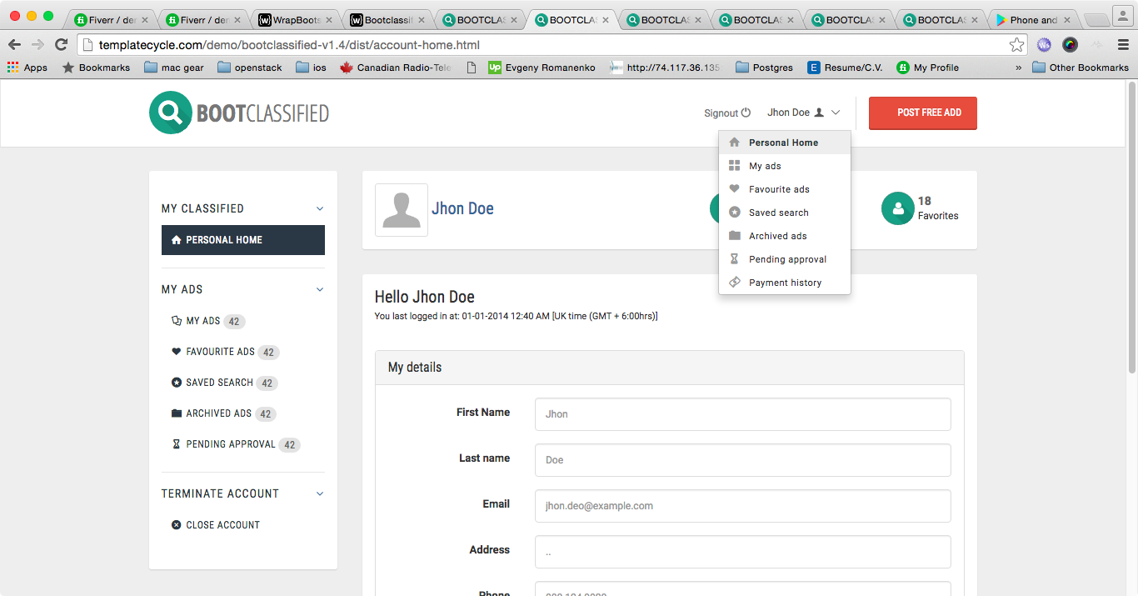
User login
Keep everything. Change ADS to Toll Free Number.

Slide 10
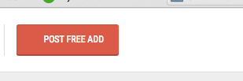
Buy Toll Free Number Button
Next to “Post My Toll Free Number”, add “Buy Toll Free Number”, and
“Port Toll Free Number”

Slide 11
Choose Your Number
1800, 1888, 1866,1877,1855,1844
[ ]
[ ]
[ ]
[ ]
[ ]
Number | Monthly Fee | Per Minute Fee
 | 1 | 0.015
 | 1 | 0.015
 | 1 | 0.015
 | 1 | 0.015
 | 1 | 0.015
Confirm
Notes:
This page will open when someone will click on buy your own Toll free number
First box with 1800, 1888, 1866,1877,1855,1844 will be in dropdown to select Toll Free number those starts with those number
Clicking on buy will open next page of this ppt.

Slide 12
1800, 1888, 1866,1877,1855,1844
Get Your Number
Plan | Monthly Fee | Per Minute Fee
Per minute Plan | 1 | .015 USD
Buy
Plan | Monthly Fee | Per Month Fee
1000 Min | 1 | 100 USD
2000 Min | 1 | 200 USD
5000 Min | 1 | 500 USD
10000 Min | 1 | 1000 USD
Buy
Buy
Buy
Buy
100 % Completion Rate
Never Worry your client can’t find you
With Pay Per Usage, You don’t lose on monthly fee
With monthly fee, you will charge with least rates
Notes:
Buy will redirect to next page.

Slide 13
New User/ Sign In
First Name
Last Name
Email
Phone Number
Address
City
State
Country
Notes:
Ask for These field to fill
In the bottom “Already a client? Sign in”
Then it will ask for username & password or Email & password

Slide 14
Payment Page
First Month Toll free number Fee = 1USD
Monthly Fee = 100USD
Total = 101 USD
Pay with paypal
Stripe payment

Slide 15
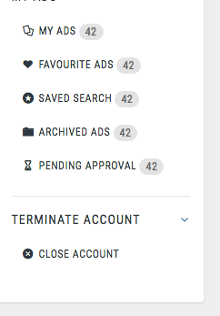
Add Menu
We need to add:
My Toll Free Number
- My Numbers
- Call Details
- Usage Report
- Payment History
- Monthly Invoices
- Forwarding Price

Slide 16
My Number
Toll Free Number | Action | Destination
1-800-xxx-xxxx | Forward | SIP: xxxx@sss.com | Change Terminate Post Test
1-800-xxx-xxxx | Forward | 1-703-333-3333 | Change Terminate Post Test
1-800-xxx-xxxx | IVR | Edit | Change Terminate Post Test
1-800-xxx-xxxx | Queue | Edit | Change Terminate Post Test
1-800-xxx-xxxx | Conference | Edit | Change Terminate Post Test

Slide 17
Edit IVR
Upload
TTS
Menu Prompt
0
Forward to Number
Number
2
Forward to SIP account
SIP: xxxx@dddd.com
9
Forward to Conference
Menu Prompt,
Hotst Pin, Guest Pin

Slide 18
Edit Support Queue
Upload
TTS
Listen
Download
Introduction Prompt
Upload
TTS
Listen
Download
Waiting Music
Upload
TTS
Listen
Download
Connection Prompt
Agents
Add New
Username | Passwod

Slide 19
Edit Conference
Upload
TTS
Listen
Download
Introduction Prompt
Host Pin
Guest Pin

Slide 20
Usage Report
Start TIme
End Time
My Toll Free
Date | Call Attempt | Connected Calls | Minutes | Cost

Slide 21
Payment History
Date | Payment Method | Amount | Transaction ID
 | Paypal
 | Skrill

Slide 22
Monthly Invoices
Date | Invoice # | Amount | Billing Period | Paid Amount
Paid Now
Paid Now

Slide 23
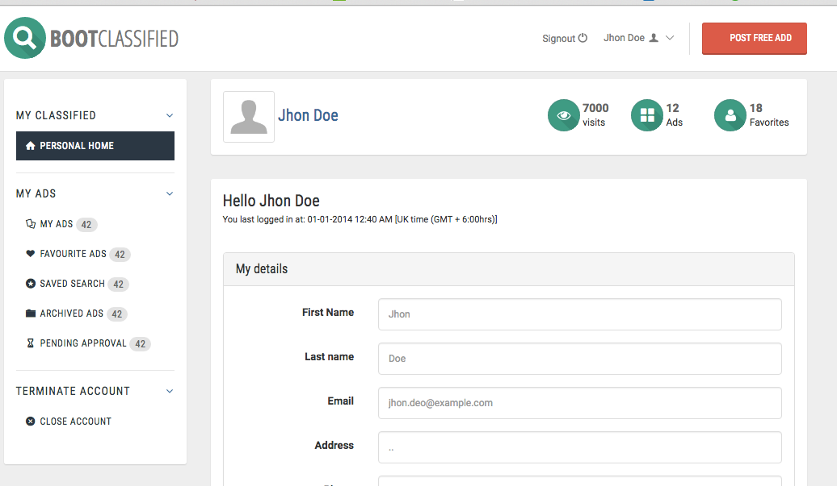
Dashboard after login
Change to XX called
First section here should be My Toll Free Numbers ( if any ).

Slide 24
Bottom of Dashboard
These two boxes should be removed.

